Slide 1
2.4G Communicate
ProjectGroup 5
List of team members:
张一弛 11813226
杨英特 11812518
李晗晓 11812511
杨林 11712323

Slide 2
Features
Communicate between two devices by 2.4G
Status notification with LED
Error detection for 2.4G module connection failure
Error detection for connection failure
Open/Close connection with commands

Slide 3
Communicate between two devices by 2.4G
Messages from server (sending out) are shown in right
Messages from client (received) are shown in left, and
highlighted with blue

Slide 4
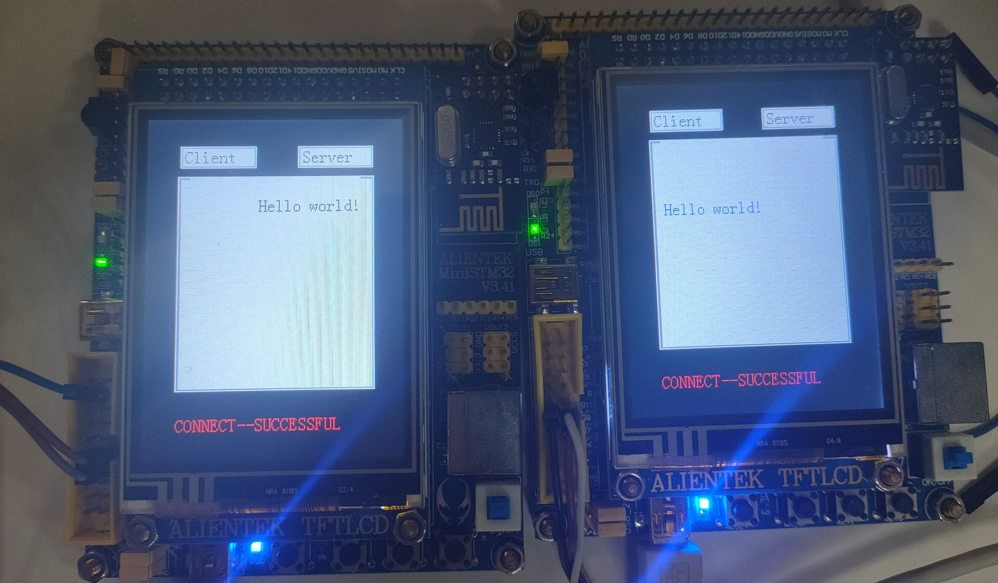
Communicate between two devices by 2.4G

Slide 5
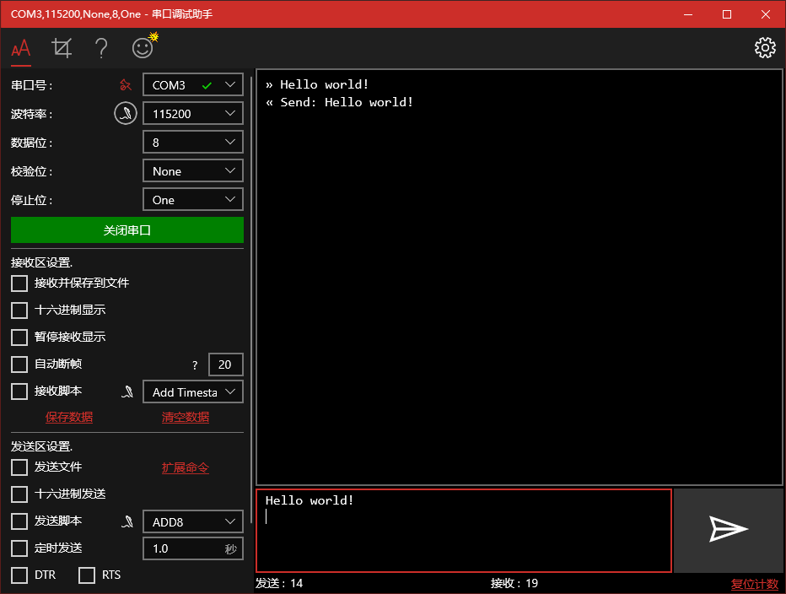
Communicate between two devices by 2.4G

Slide 6
Communicate between two devices by 2.4G
Format of a message to be sent:
{$message}\r\n
In which “\r\n” means the end of a message

Slide 7
Control with Key on Board
KEY0: Connect with other boards
KEY1: Cancel Connection

Slide 8
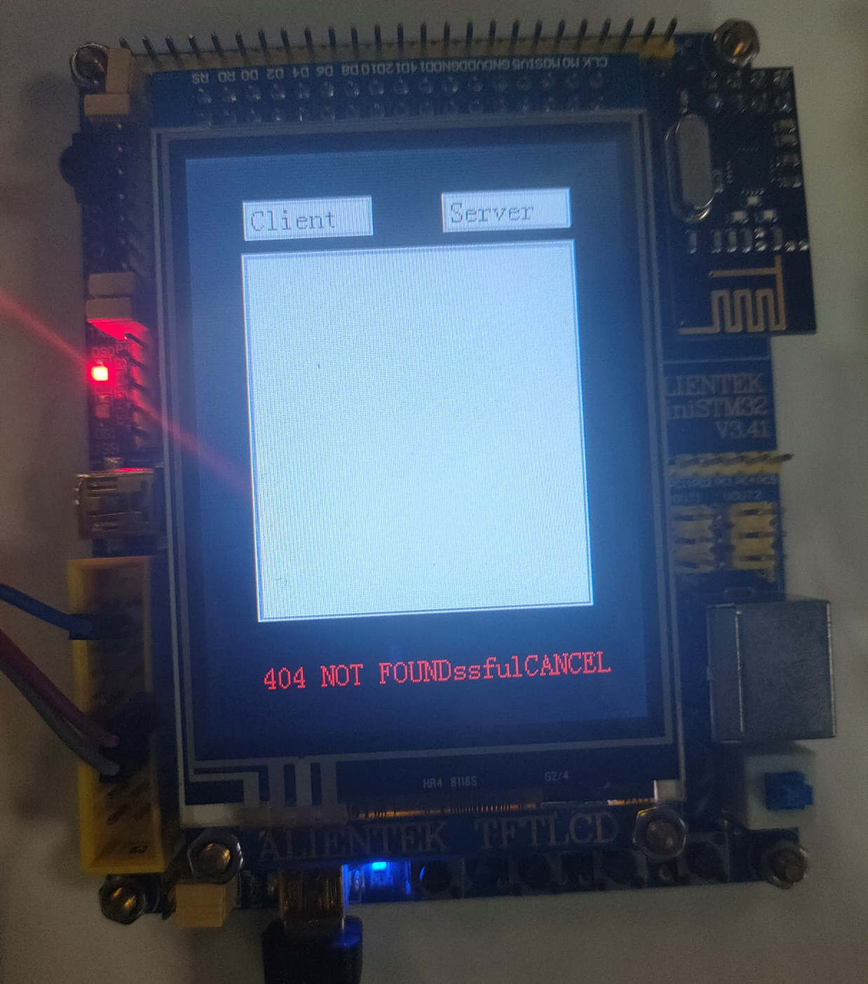
Error detection for connection failure

Slide 9
Error detection for 2.4G module connection failure
Report if the module is pulled out / bad connected
Recover after plugged immediately without reset

Slide 10
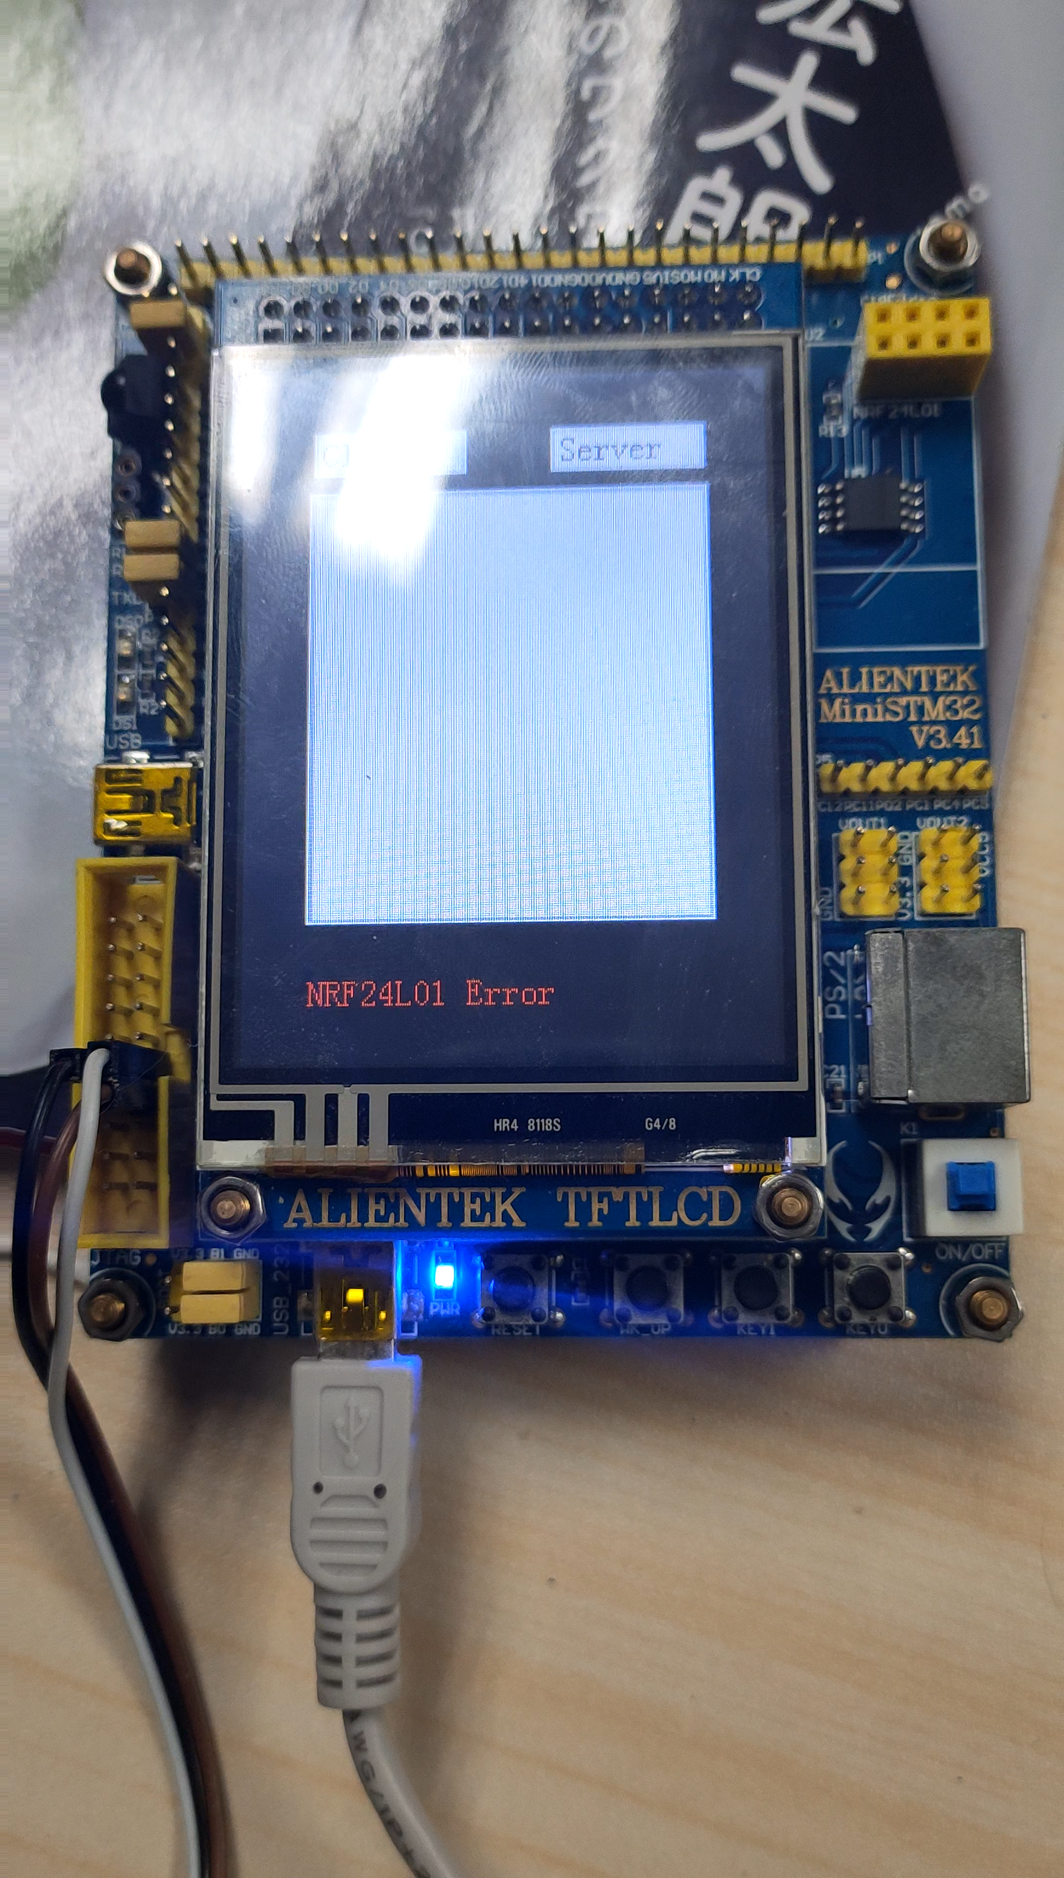
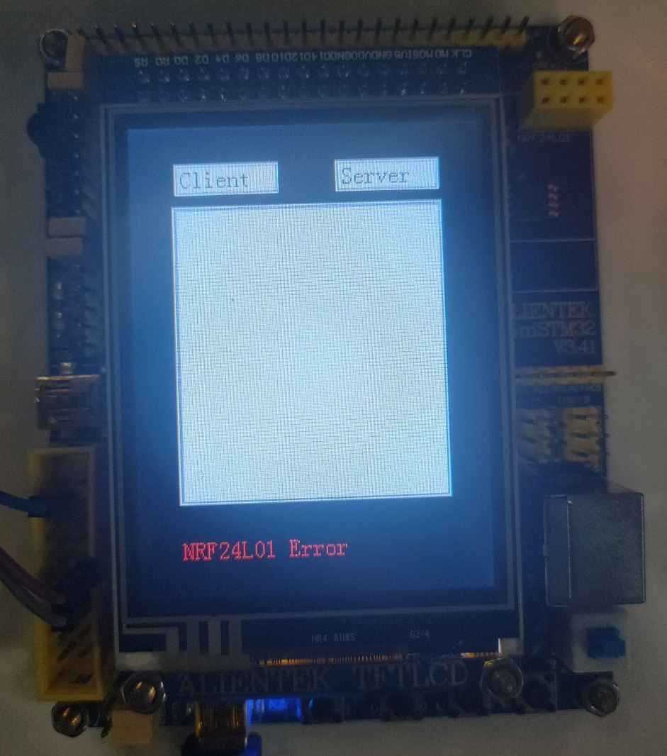
Error detection for 2.4G module connection failure

Slide 11
Status notification with LED
Green light means connected successfully
Red light means error, and errors are printed on LCD
Long red light → cannot establish connection
blinking red light → hardware error
(2.4G module not recognized…)

Slide 12
Open/Close connection with commands
Open\r\n → Open connection
Close\r\n → Close connection

Slide 13
Thanks
List of team members:
张一弛 11813226
杨英特 11812518
李晗晓 11812511
杨林 11712323

